Slide 1
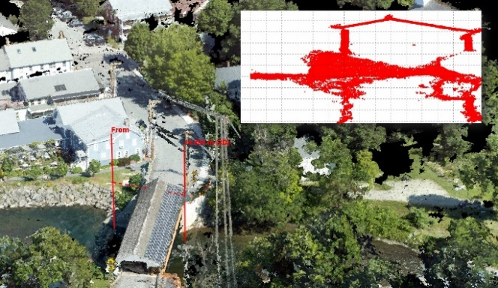
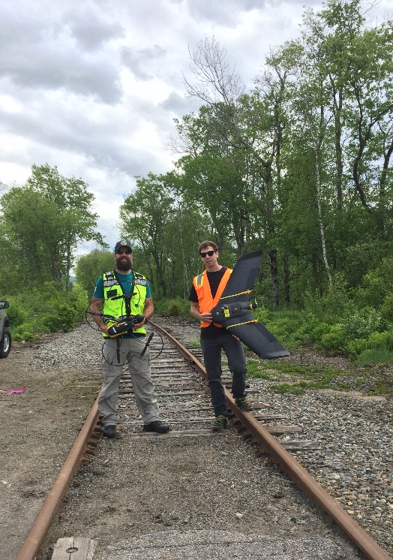
 | FACT SHEET
& STIC Annual Meeting
Unmanned Aerial Systems for Transportation Decision Support STUDY TIMELINE September 2014 – August 2016 PRINCIPAL INVESTIGATOR Jarlath O’Neil-Dunne, University of Vermont, PI VTRANS CONTACT(S) Stephen Smith MORE INFORMATION Research will add link to the final report and other materials on VTrans website This fact sheet was prepared for the 2017 VTrans Research Symposium & STIC Annual Meeting held on September 28, 2017 at National Life in Montpelier, VT. 8:00 am– 12:00 pm. Fact sheets can be found for additional projects featured at the 2017 Symposium at http://vtrans.vermont.gov/planning/research/2017symposium Additional information about the VTrans Research Program can be found at http://vtrans.vermont.gov/planning/research Additional information about the VTrans STIC Program can be found at http://vtrans.vermont.gov/boards-councils/stic | Executive Summary Our nation relies on accurate geospatial information to map, measure, and monitor transportation infrastructure and the surrounding landscapes. This project focused on the application of Unmanned Aircraft Systems (UAS) as a novel tool for improving efficiency and efficacy of geospatial data acquisition to improve transportation decision support
2017 Research
Symposium
Unmanned Aerial Systems for Transportation Decision Support
Project Highlights
Bridges in New England are some of the oldest in the nation. They are difficult and costly to inspect. A multi-rotor UAS with swivel head sensors was employed to capture imagery of locations no human could easily reach. Coupled with 3D models of unprecedented detail, UAS proved to be a cost-effective technology for documenting the precise configurations of bridges.
Natural disasters stress transportation resource allocation systems as managers struggle to respond to multiple competing threats. In late February 2015 unseasonably warm temperatures and rain in Vermont caused ice on rivers to break up, resulting in ice jams and flooding. Emergency operation managers needed to know what areas were at risk, but a low cloud ceiling rendered traditional aerial assets useless. Our UAS Team rapidly deployed throughout the state to assess risk and document high-water conditions. The UAS team was able to acquire imagery at multiple sites where roads and railways were impacted by rising waters stemming from the ice jams. 2D and 3D geospatial products were generated allowing managers to determine the risk rising waters posed to key pieces of the transportation network. The UAS data also served to document flood conditions, data that will be used in future redesign initiatives.
UAS Benefits
UAS Limitations
Access difficult to reach areas
Weather
Safer & faster than traditional methods
Battery Life
Cost saving
Equipment malfunction
Geospatial & 3D data
Expertise required

